Slide 1








PLAY, LEARN and CREATE with
Olivier Heidmann
Software Engineer, Consultant
Pilot Lead, EU H2020 Beaconing Project
Sylvester Arnab, PhD
Professor of Game Science
Coordinator, EU H2020 Beaconing Project
http://sylvesterarnab.com
@sarnab75 @BeaconingEU
Notes:
Both

Slide 2
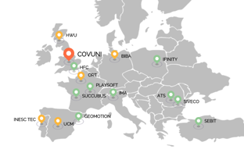



“Breaking Educational Barriers with Contextualised, Pervasive and Gameful Learning”
http://Beaconing.eu
Notes:
“Breaking Educational Barriers with Contextualised, Pervasive and Gameful Learning”

Slide 3

CC BY-NC-ND 2.0
Photo and story by Jordan Arseno.
How to make sense of education?
#disrupt_learn
Notes:
Our learning space is getting more hybrid, where the boundaries between digital and physical contexts and spaces are blurring. Experience is more mobile!

Slide 4
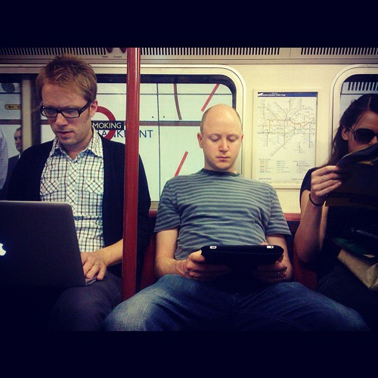



hybrid-space
collaborative-curated
#disrupt_learn
Notes:
SH
Our learning space don’t seek to
distinguish between physical and digital, instead we can engage students in active learning and PRODUCTION wherever they are.

Slide 5

Learning “spaces”: Merging Physical and Digital?

Slide 6
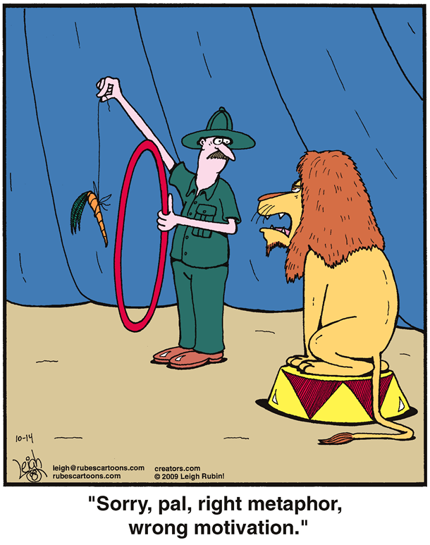
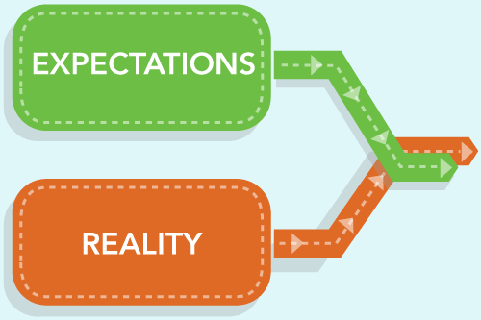
How do we motivate learners in this changing landscape?

Slide 7
How do we harness the power of play?

Slide 8

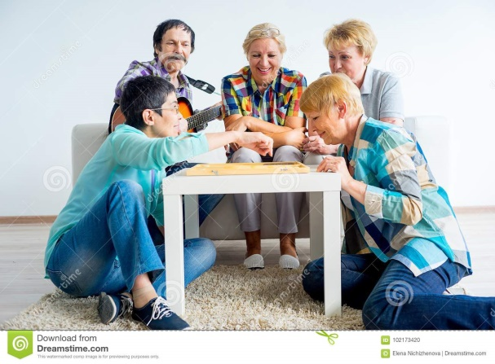


Can we create this experience? This excitement? The wonder? The enjoyment?

Slide 9


Slide 10

Notes:
We will play this video to set the scene for one of the project –Beaconing- an EU funded project with 15 partners and Coventry is leading this- valued at over 5 million euros.

Slide 11
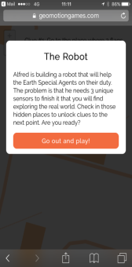
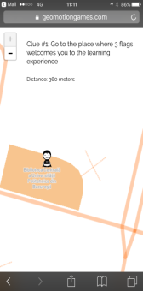
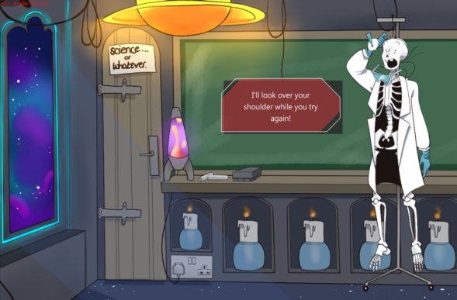
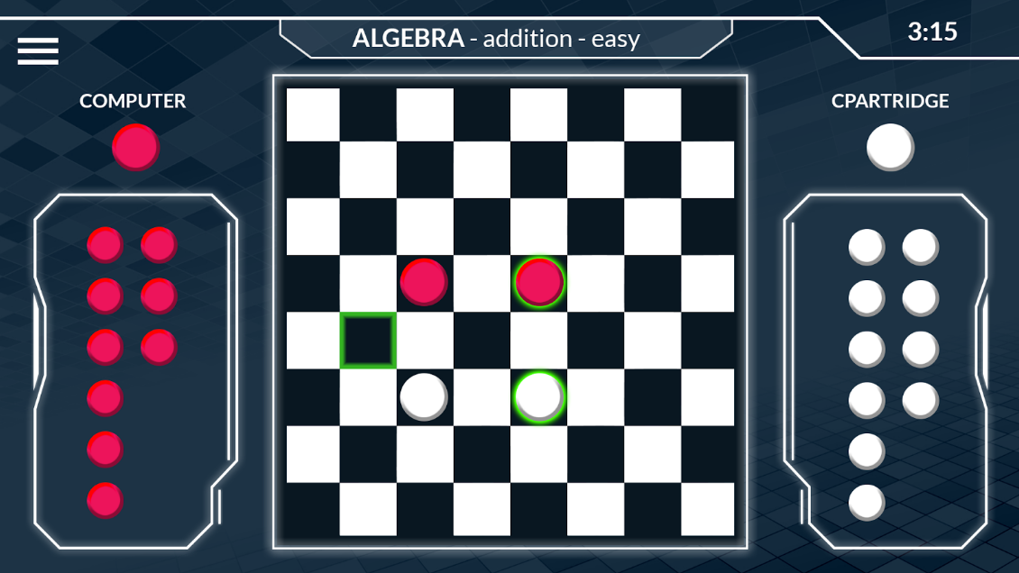
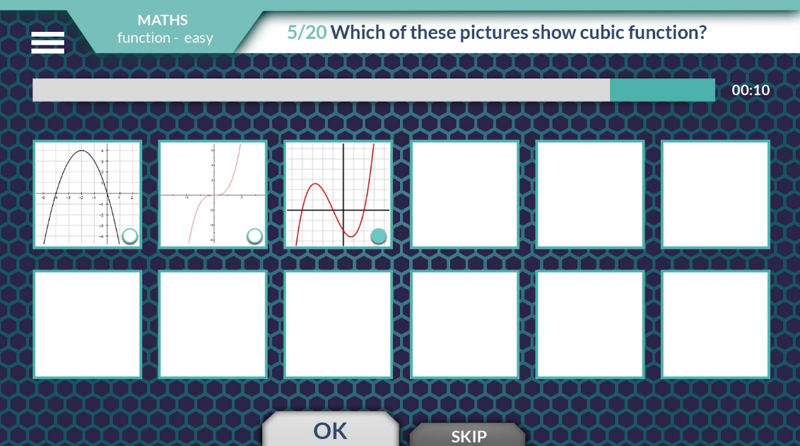
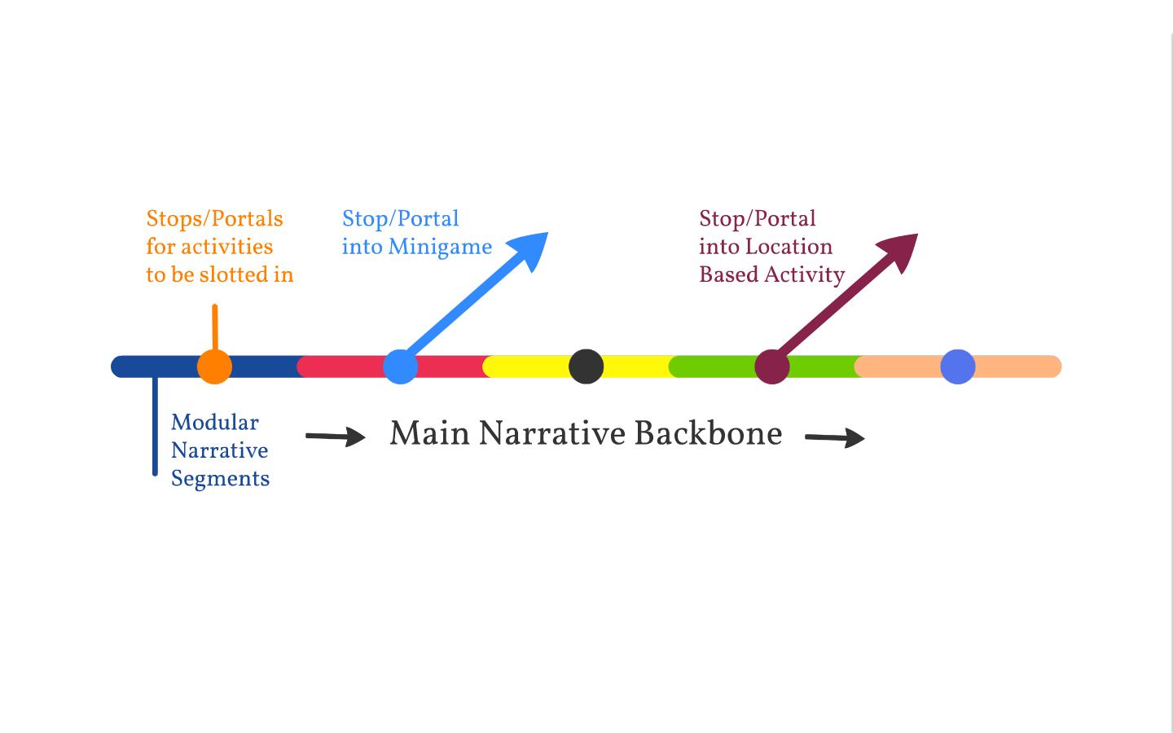
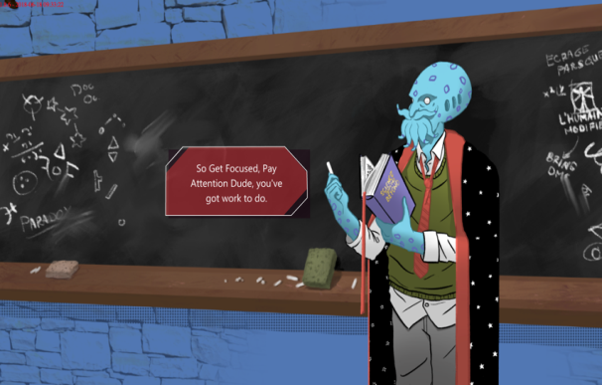
The backbone: a narrative running through a lesson plan
Notes:
The idea is for a narrative to represent a lesson plan. The different game objects such as mini games will be embedded in the narrative to support the learning.

Slide 12
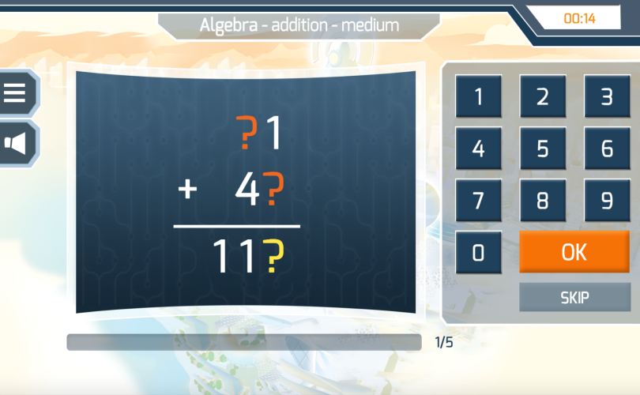
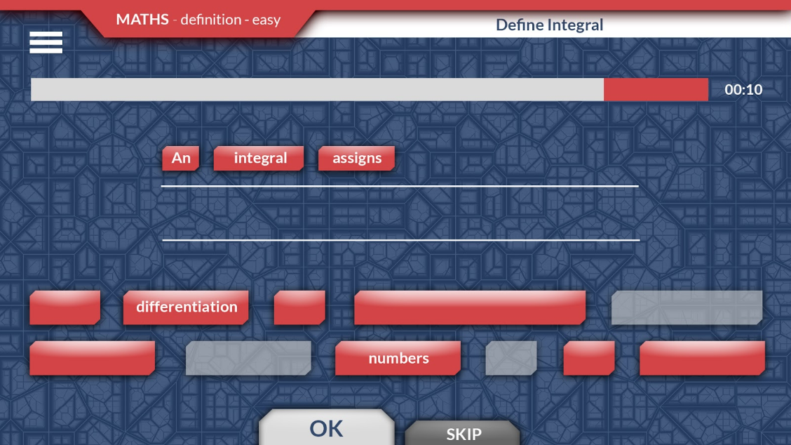
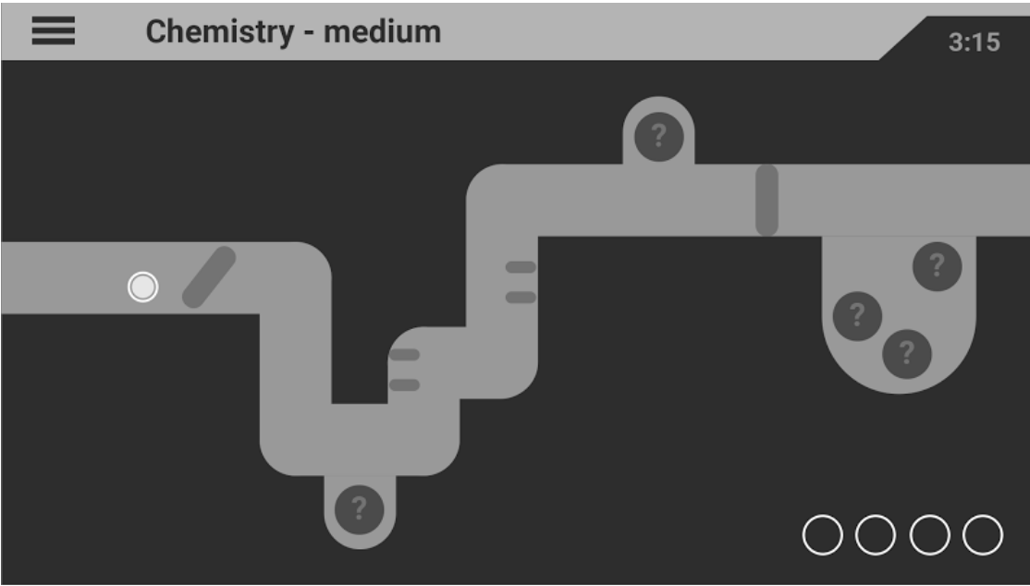
Author-able Mini Games
Notes:
Through our research, there is value in learning in smaller chunks linking to atomic learning concept, in order to make learning more management and measurable. We use minigames to represent the different learning or topics based on the subject and we have over 400 instances of the different types of mini-games that are authorable.

Slide 13
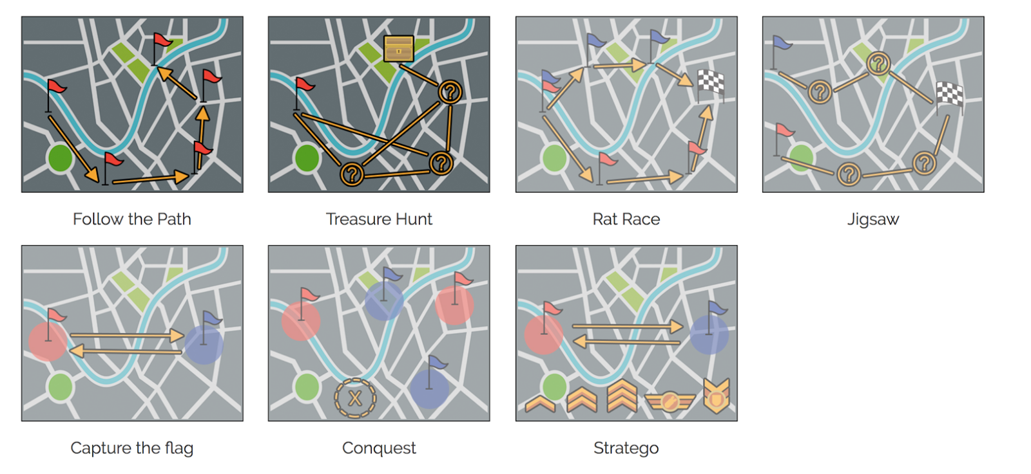
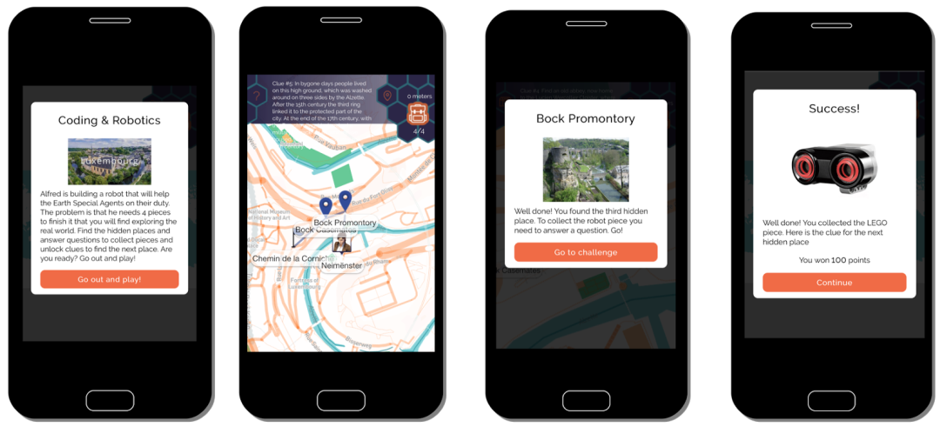
Authorable Location-Based games
Notes:
Most importantly, the game activities included location-based functionality – where you can learn while being outdoor. Triggered by GPS, QR codes or Beacons. Teacher can author this as well!

Slide 14
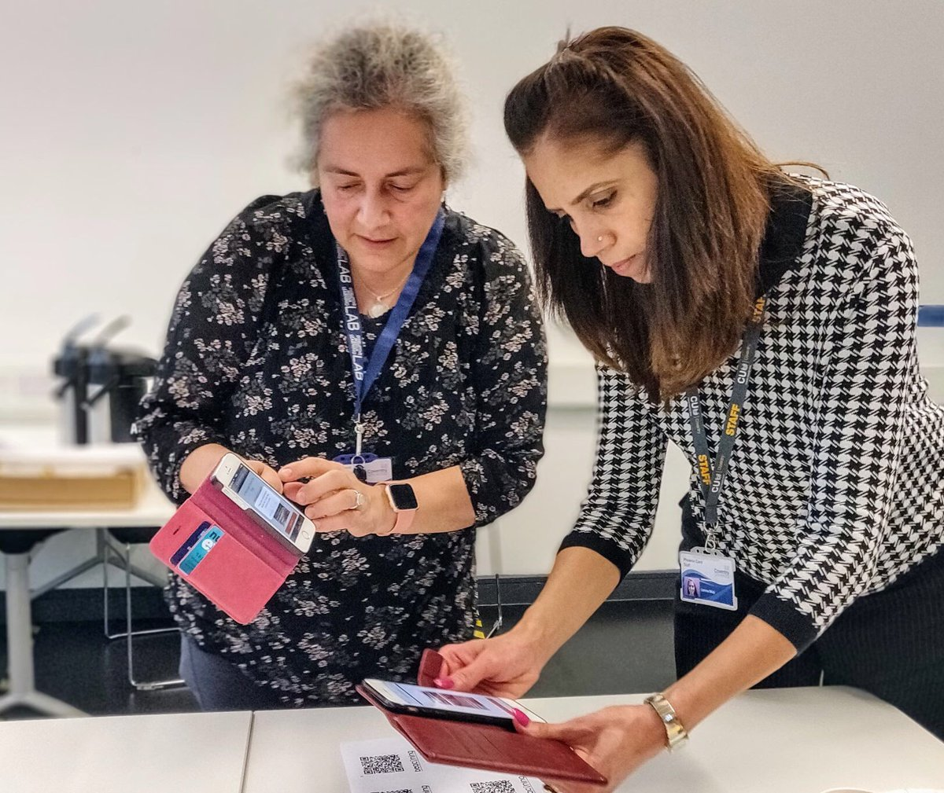
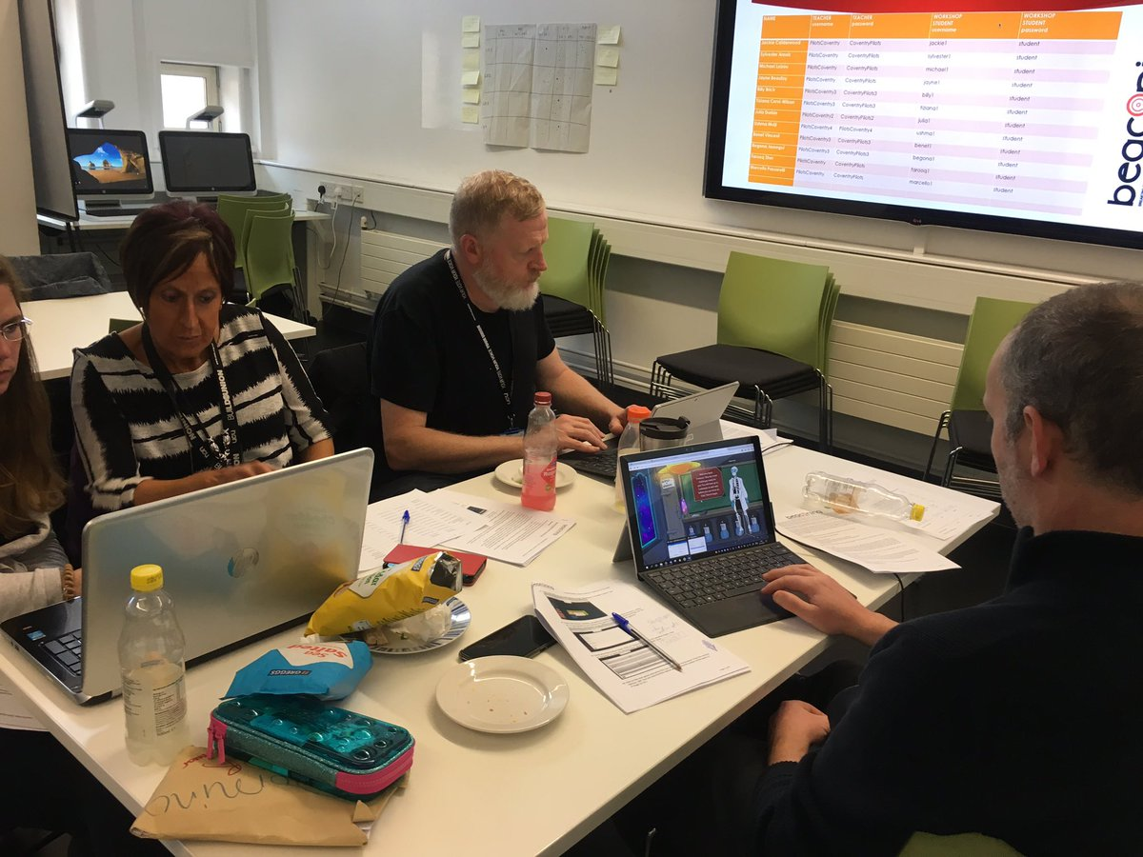
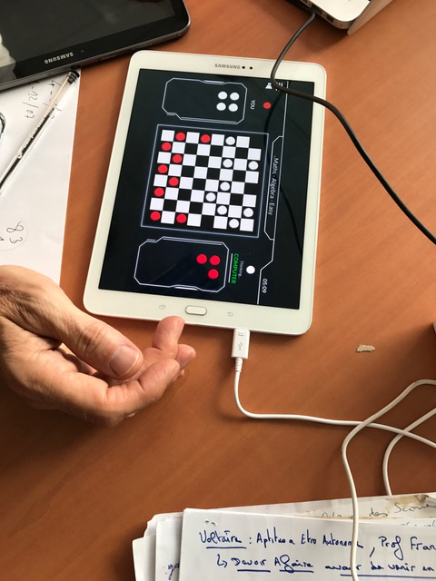


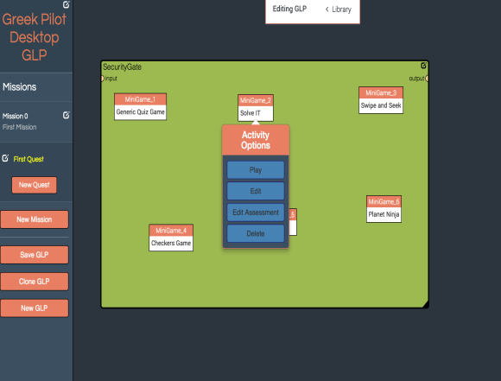
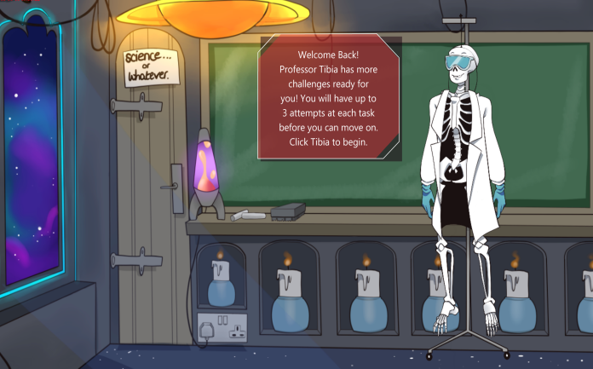

Breaking barriers to (co) creating gamified lessons

Slide 15

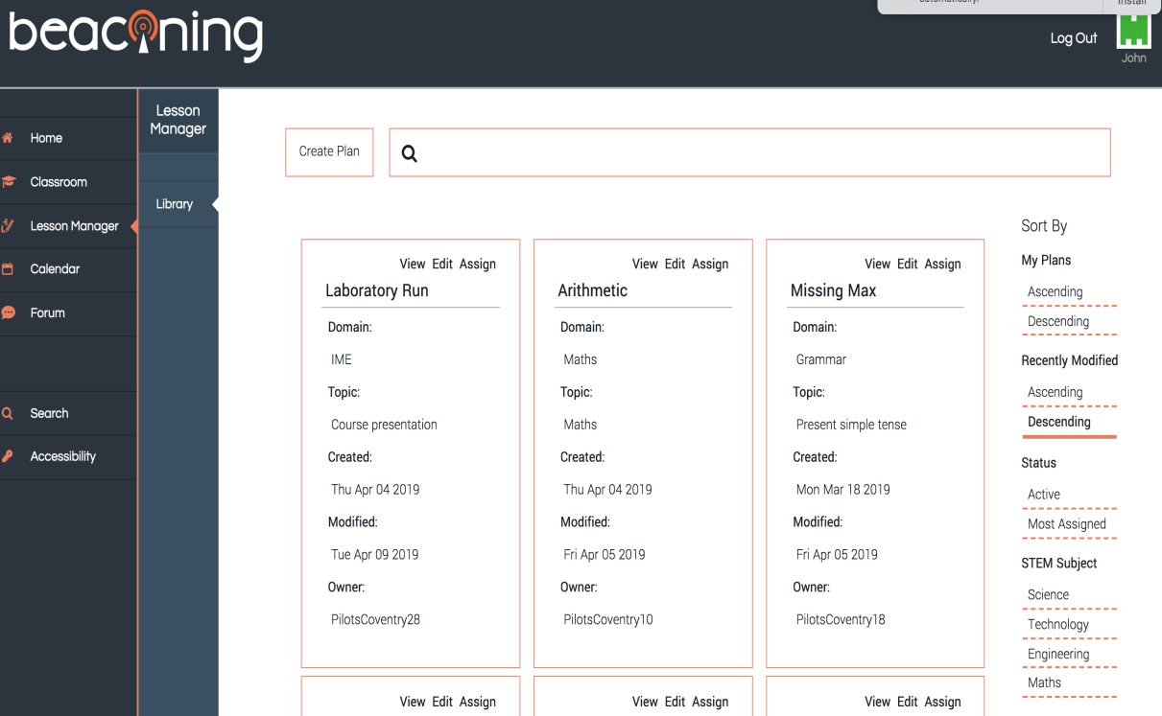
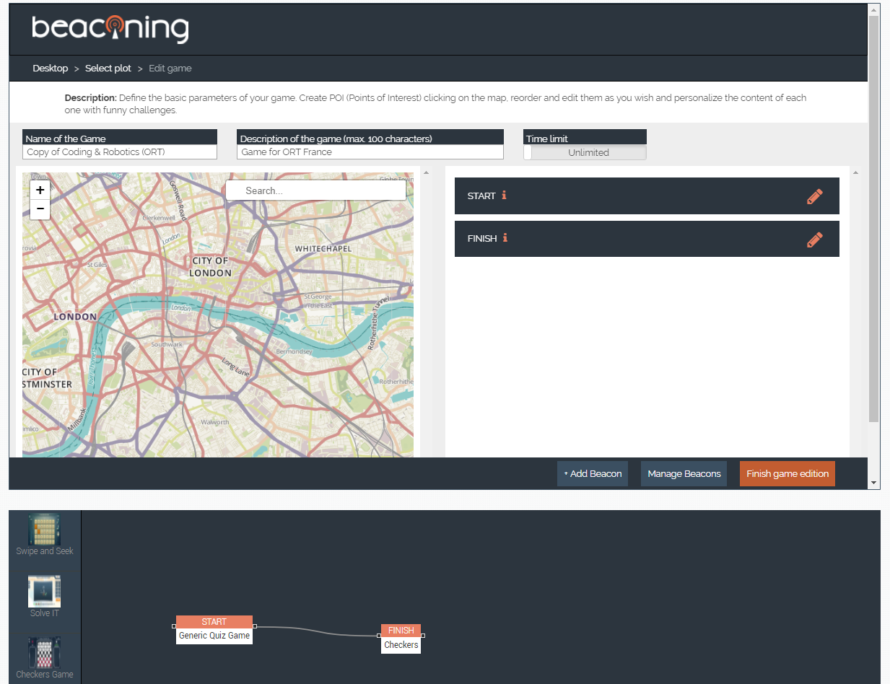
Teacher Dashboard and Authoring tools:
Empowering teachers to create
Notes:
Key thing we would like to achieve is to reduce the barrier for teachers- to allow non-programmer to create their own gamified lesson plans.

Slide 16

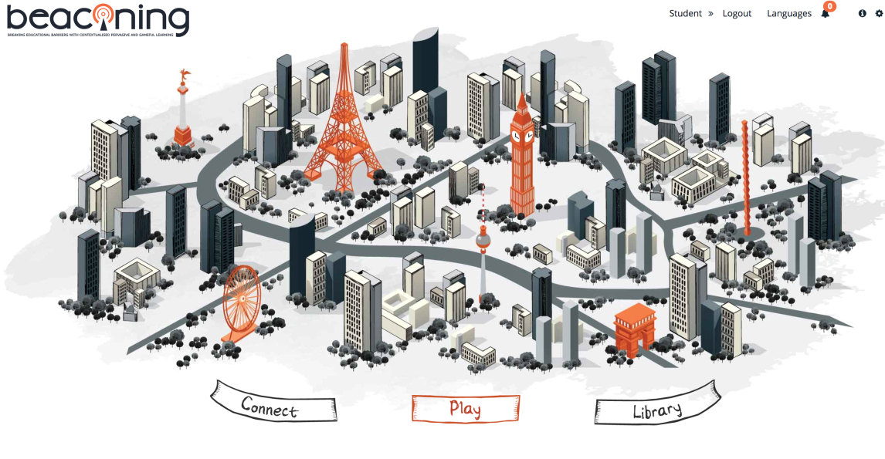
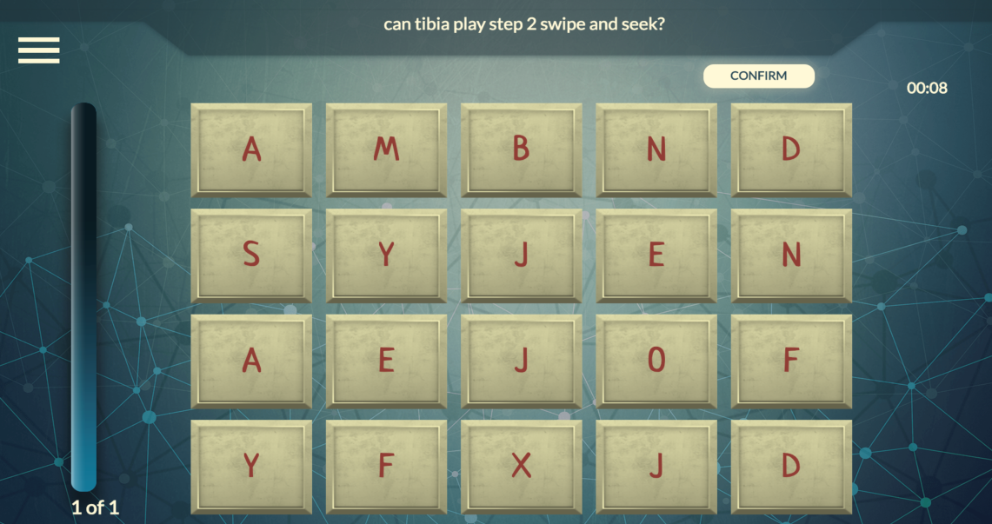
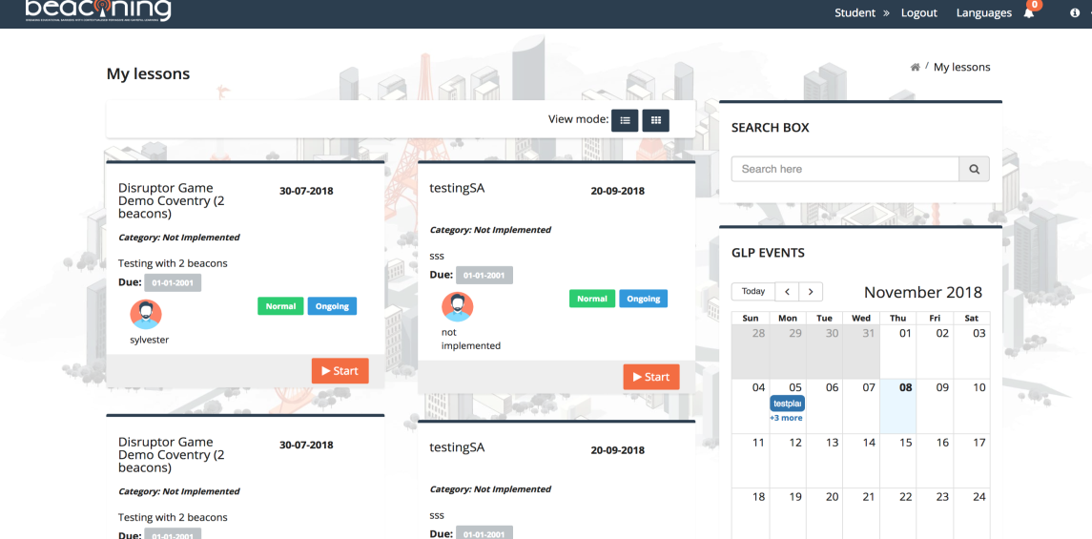
Student Access
Notes:
Teachers can assign those lessons to the students and they can access these through their personal dashboard.

Slide 17
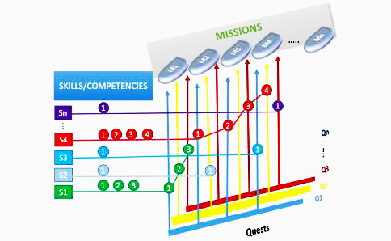
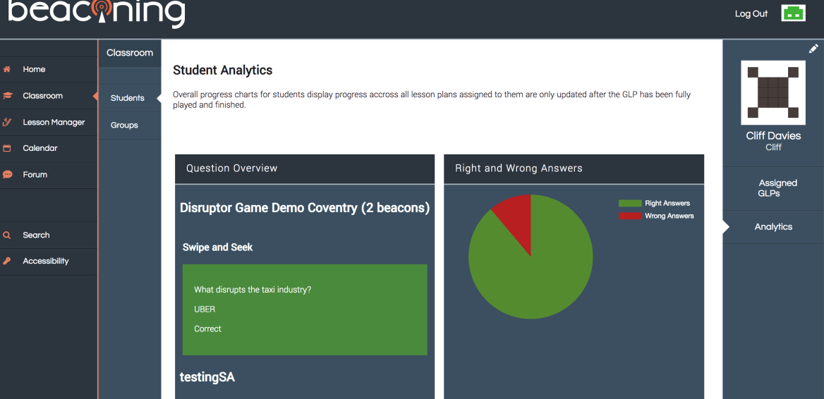
Tracking activities: towards Analytics and Actionable feedback
Lesson path
Notes:
Also the possibility to track the activities using our analytics. This will help teachers to identify weak areas that need to be emphasised in the classroom.

Slide 18
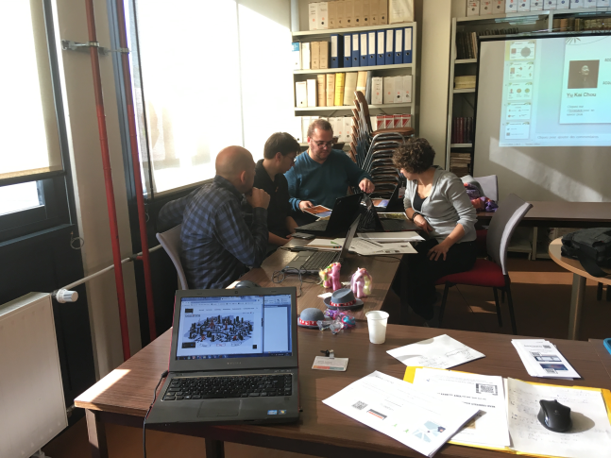
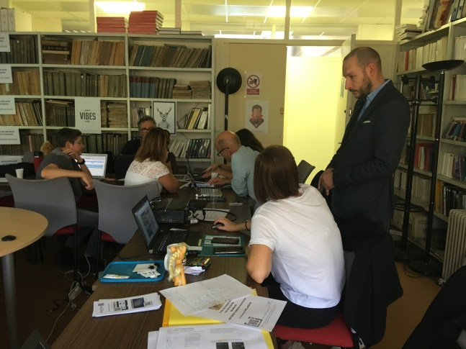
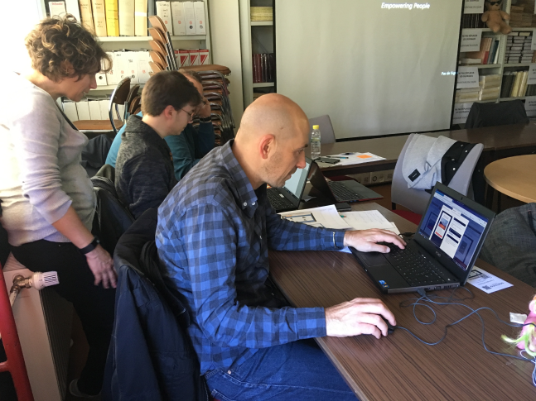
Small scale pilots – Testing the formula
Spring 2018 – October 2018
600 teachers involved
France, Israel, Bulgaria, Italy, South Africa

Slide 19
Large scale pilots – Europe and Beyond
Large Scale Pilots - >6000 stakeholders
ORT
France: 7 schools, 100 teachers, 1000 students
Greece: 2 schools, 100 teachers, 1000 students
Poland: 1 school, 50 teachers, 150 students
Italy: 1 school, 10 teachers, 100 students
Bulgaria: 1 school, 90 students,______
10 teachers
SIVECO
Romania:14 schools, 73 teachers and 488 students
At least 15 students with special needs
SEBIT
Schools that are part of the Turkish National Educational IT Network
500 teachers and 2000 students
ORT
South Africa: 1 school, 15 teachers and 400 students
Israel: 4 schools, 100 teachers and 1000 students
International Large Scale Pilots | Total | Students | Teachers
France | 2040 | 1650 | 390
Greece | 150 | 145 | 5
BULGARIA | 100 | 90 | 10
ITALIA | 100 | 80 | 20
ISRAEL | 300 | 200 | 100
POLAND | 200 | 150 | 50
South Africa | 20 |  | 20
Turkey | 2060 | 1990 | 90
Romania | 950 | 900 | 50
UK | 103 | 72 | 31
TOTAL | 6043 | 5277 | 766
Video EXAMPLE of BEACONING with the 9th Grade in ISTANBUL: https://www.youtube.com/watch?v=zO-D2JjTst0

Slide 20
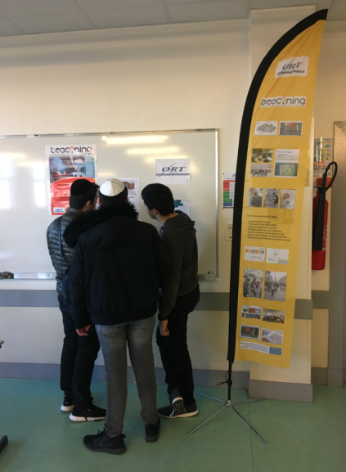
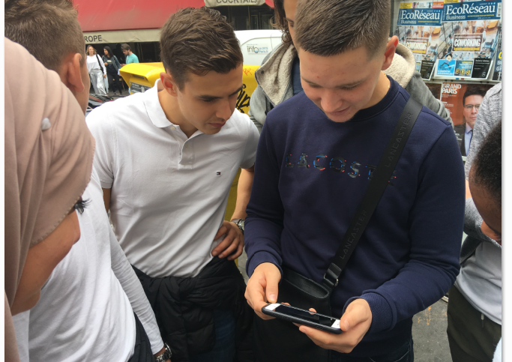
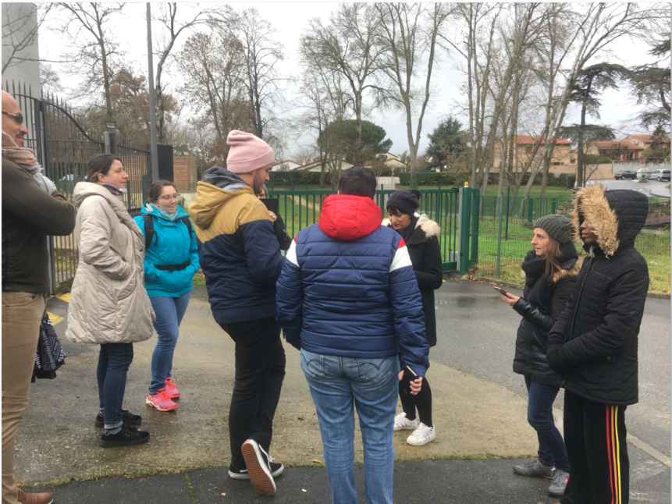
Geolocation-based activities

Slide 21

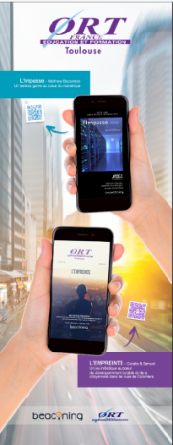
Geolocation-based activities spinoffs

Slide 22
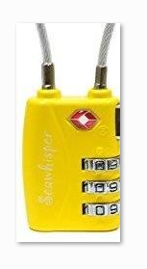
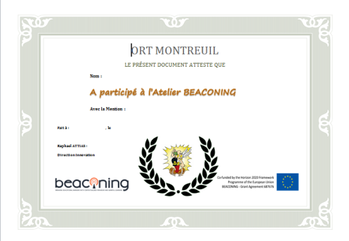

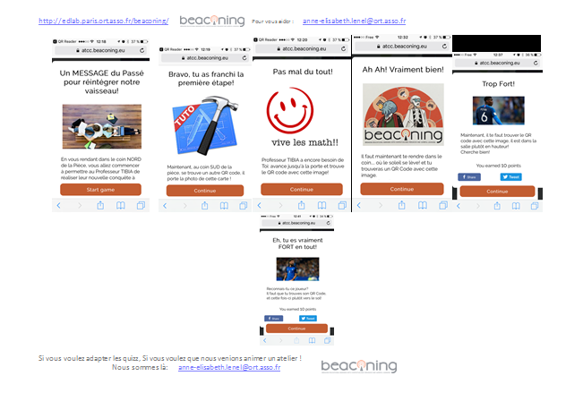
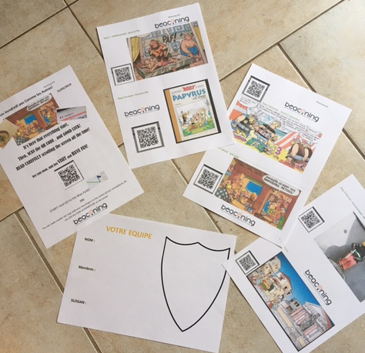
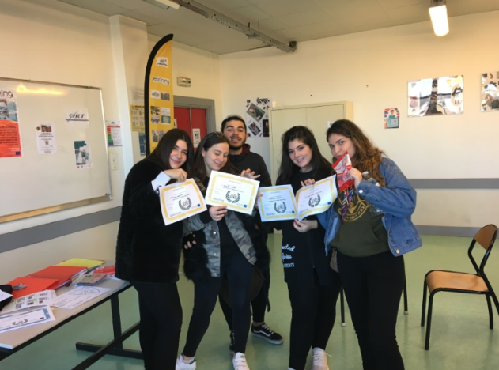
Geolocation-based activities How To

Slide 23
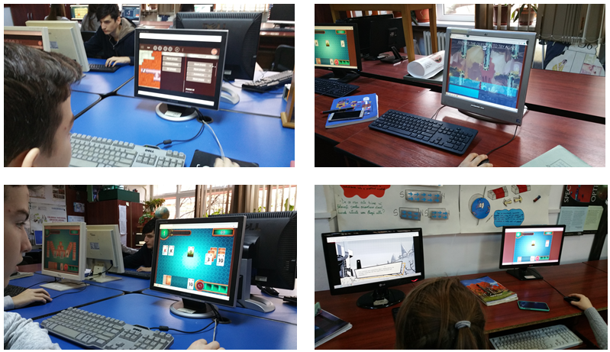
Desktop-based during an event

Slide 24
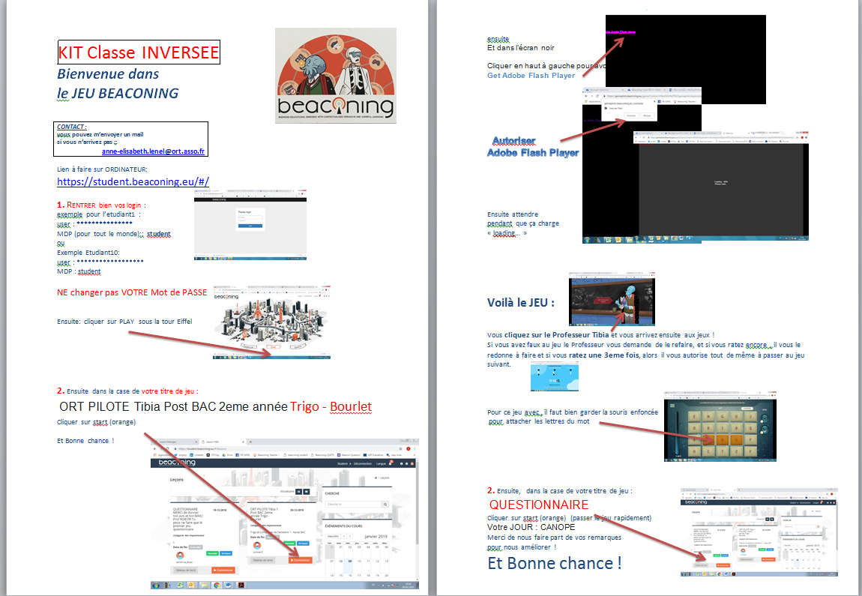
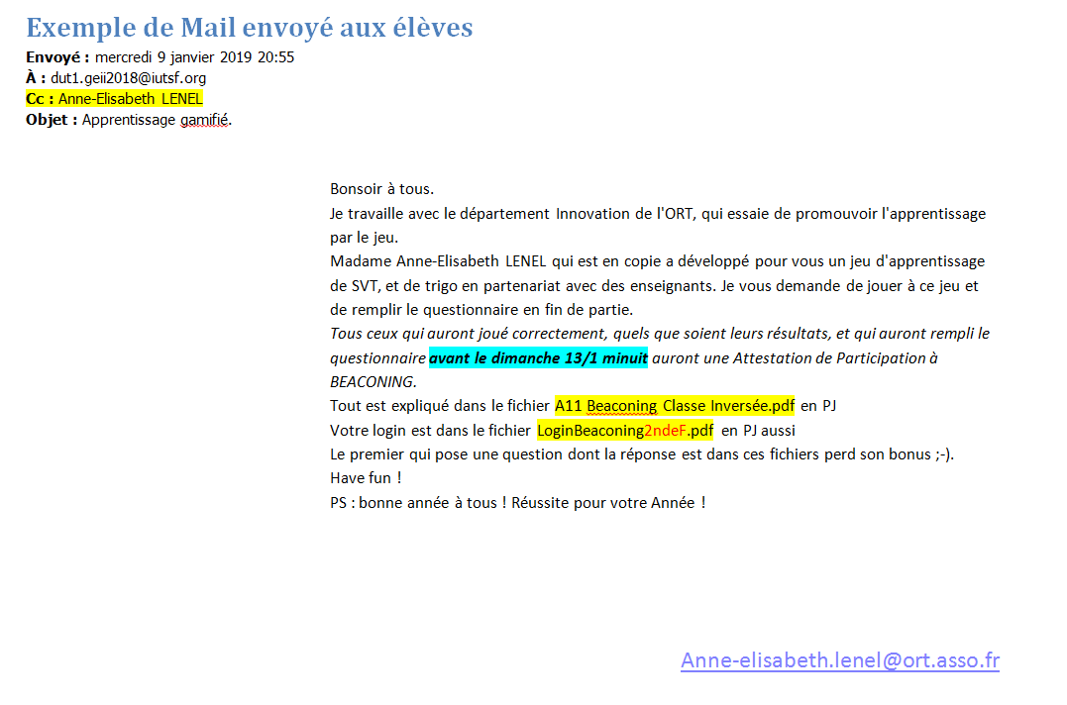
Flipped classroom

Slide 25
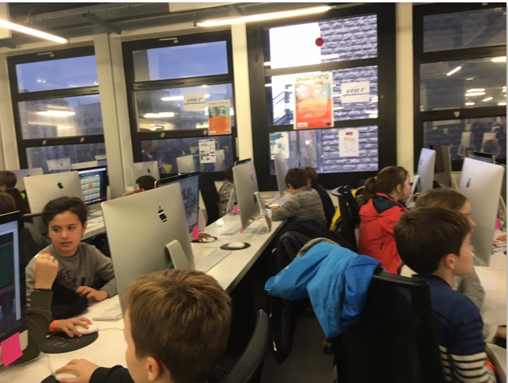
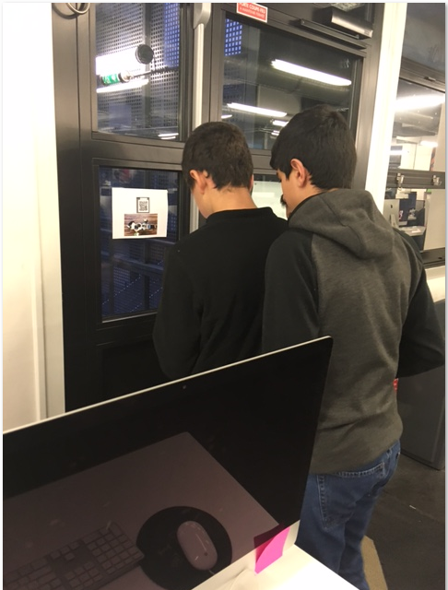
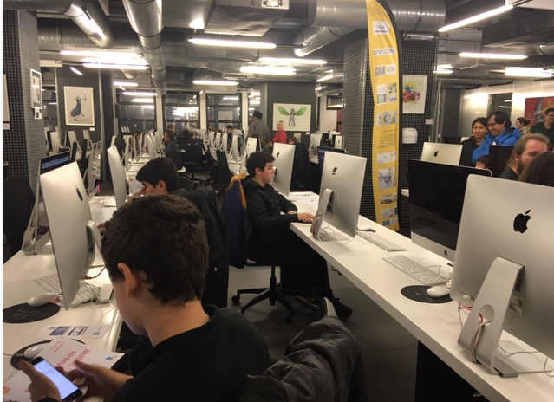
Mixed

Slide 26
Feedback – focus groups
Good tool to help teachers struggling with the digital challenge
Powerful tool that requires a framework of usage
Engaging and fun
Fosters soft skills
Freedom of interaction
Debriefing for self reflection
Teachers/students enjoyed the experience, want to try it again

Slide 27
Feedback - questionnaire

Slide 28
Feedback - questionnaire

Slide 29
Feedback - questionnaire

Slide 30


Thank You!
Video EXAMPLE of BEACONING with the 9th Grade in ISTANBUL: https://www.youtube.com/watch?v=zO-D2JjTst0
Notes:
Both

